Slide 1
NYC Datascience PROJECT 3 Kaggle Zillow
$how us the money
Markson
Shu
In Suk

Slide 2
GOT
DATA
WORK?
WHAT?

Slide 3
GOT DATA?
We have seen many missing values
in the properties data set..
How many missing values are there
for each feature? In fact, some
features are missing nearly
completely.
There are 29 out of 58 features
having missing values over 70 percent
of each column.
01

Slide 4
How to Handle the Missing Data?
The more missingness a feature has, the less important it will be.
We removed the less important features.
Set a threshold?
30%
29 columns were removed.
We also removed features that have
duplicated meanings.

Slide 5
Featuring Engineering
Dataset
Cataegorical
Numeric
Generate New Features..
Dummy Variables
0/1
Median Value Imputation
Scale
Mean Value Imputation
‘roomcnt’ = ‘bathroomcnt’ + bedroomcnt’ + 1

Slide 6
WORK?
FIND
IMPORTANT
FEATURES
Estimate
With the Most
8 Contributors
Add
UNIQUE
Features

Slide 10
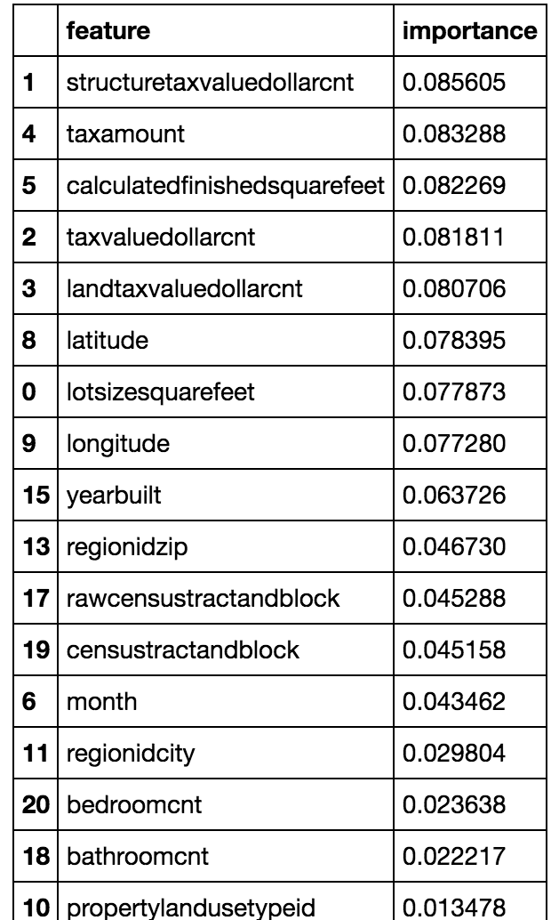
Random Forest
Region features matter.
Mean Absolute Error =
0.07071

Slide 11
How about add more features?
We added some numeric features that might be linear related with logerror and also sensitive to regions.
= ‘calculatedfinishedsquarefeet’ / ‘roomcnt’
‘Average Square Feet per Room’
‘Tax per Square Feet’ = ‘taxvaluedollarcnt’ / ‘calculatedfinishedsquarefeet’
‘

Slide 12
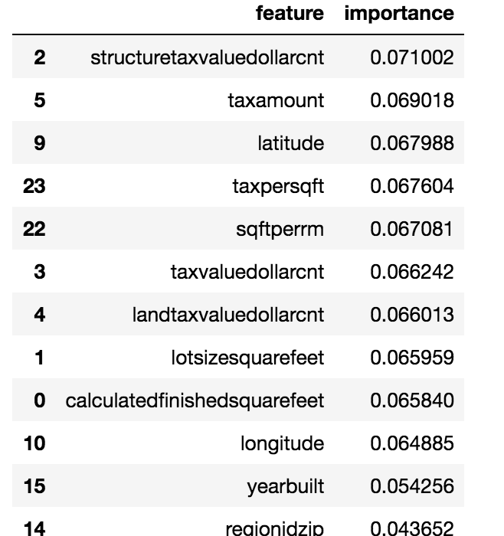
Mean Absolute Error =
0.06838

Slide 13
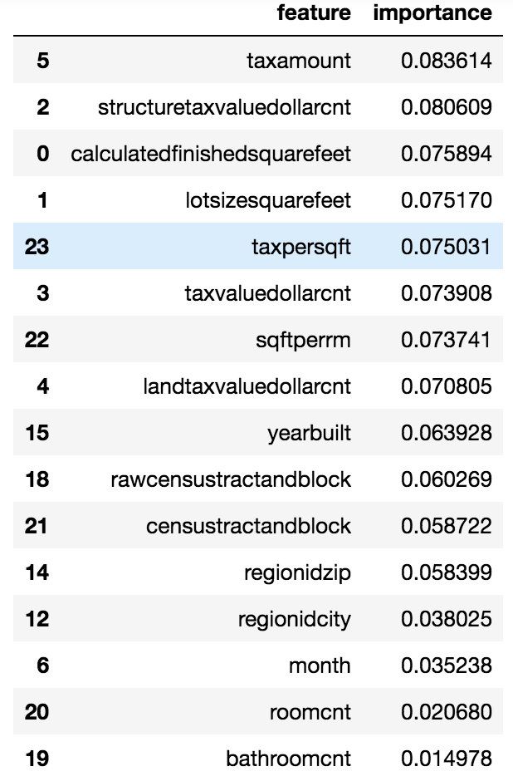
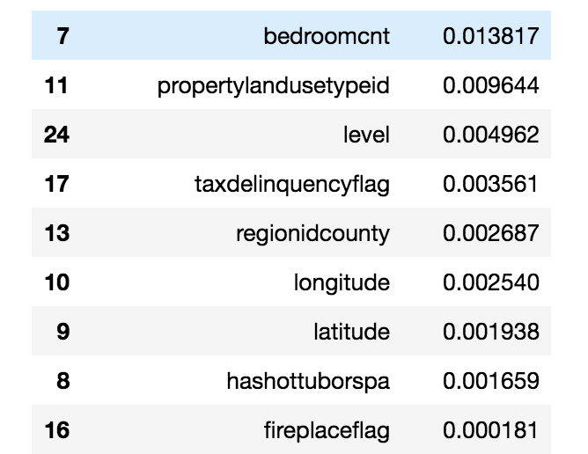
Kmeans Clustering on Regions
4 Region related categories:
House Conditions
Mean Absolute Error =
0.06846

